Slide 1
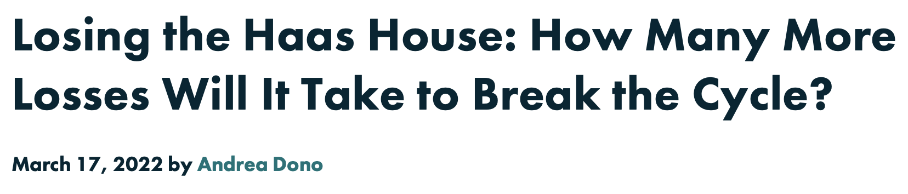
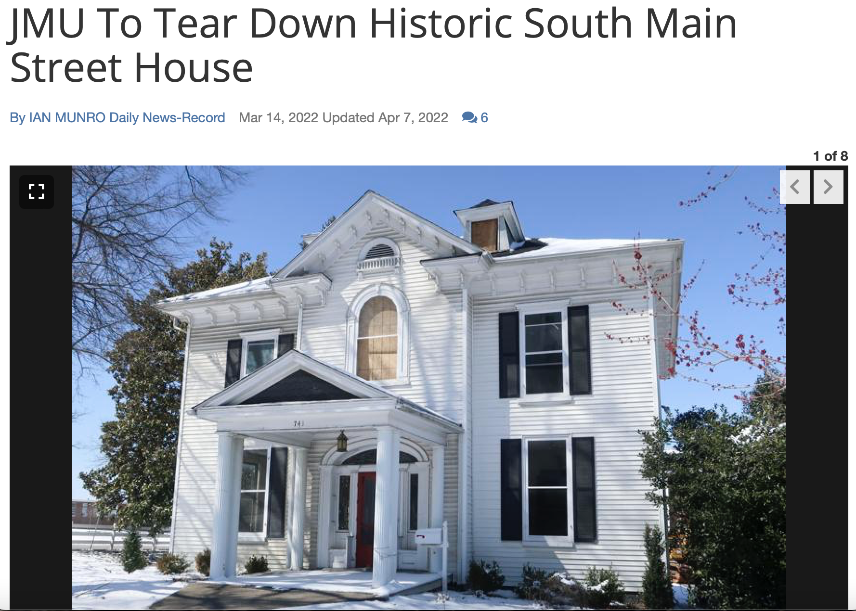
Background
“Each time we lose a historic building in Harrisonburg, community members get angry, they lament the loss, and then this cycle repeats when another historic building is demolished. This keeps happening because we don’t have a local historic district with controls in place to protect our irreplaceable buildings that embody our history.” - Downtown Historic Renaissance
Notes:
Our story starts with the Haas House, which was demolished last spring by JMU and was the oldest building left on South Main Street. The demolition was met with a lot of controversy, with JMU saying that experts told them it was unsalvageable, but local historians saying that atleast portions of the house were able to be preserved. Nonetheless, the house was bulldozed and is now a green space. The quote from the Downtown Historic Renaissance describes that this occurrence is a pattern of historical buildings being destroyed with little cause. But, why do we care? That’s what we want to find out.

Slide 2
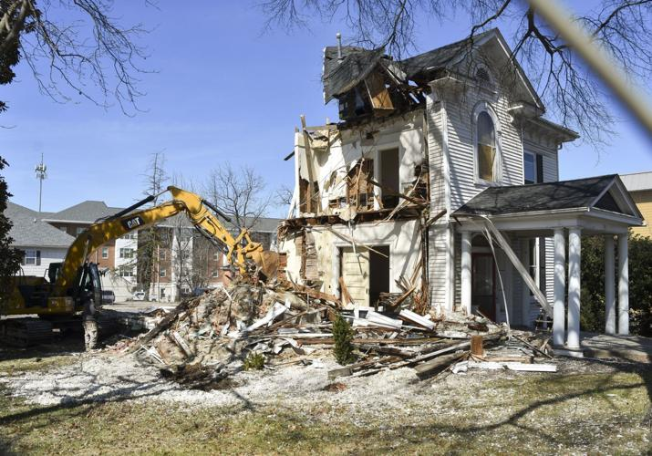
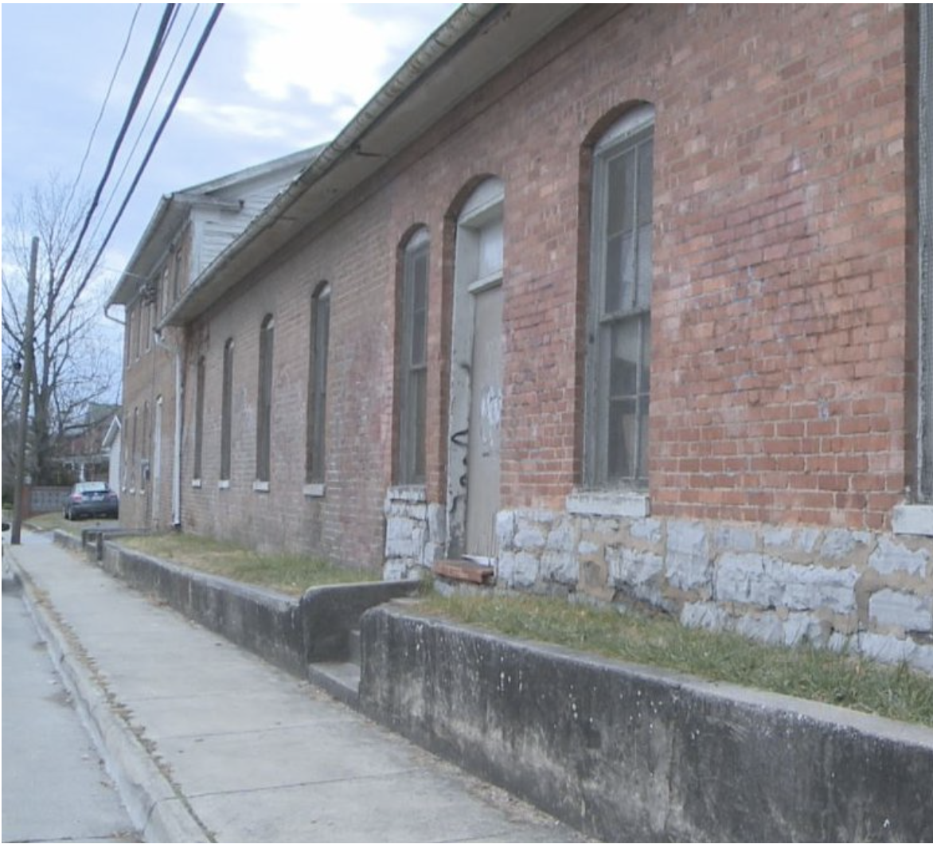
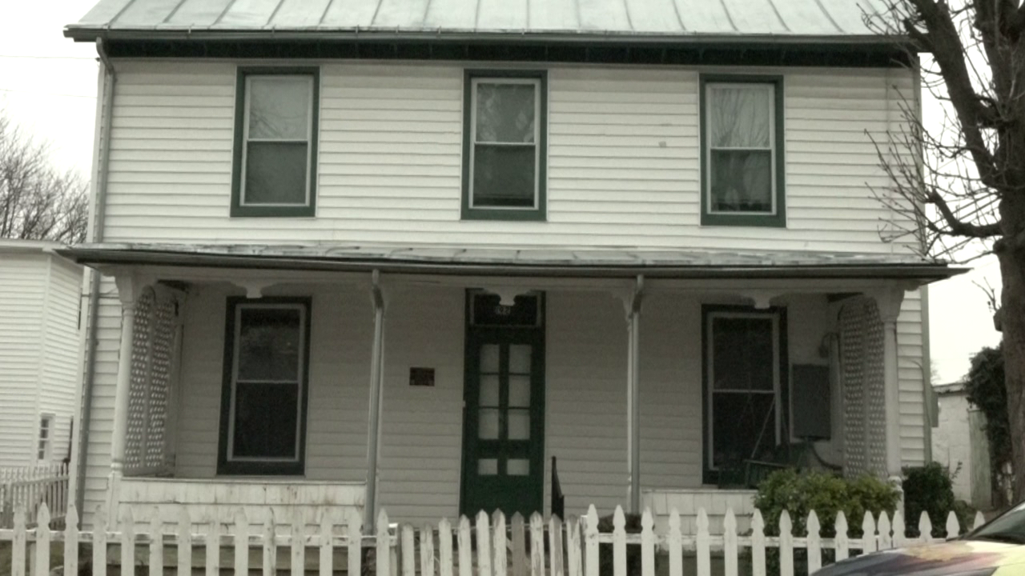
Our Buildings
Destroyed
What’s next?
We’re going to look at houses in different statuses of upkeep.
Preserved
Haas House
P. Bradley and Sons Foundry
Dallard-Newman House
Notes:
This project will not be chronological, but rather an issue-based story. So, we want to start with the Haas House which is the most recent demolition. Then, transition to the foundry and other smaller buildings discussing the buildings that are in “limbo”: still standing with the possibility of being destroyed, or just sitting there with nothing happening. Lastly, we will focus on the Dallard-Newman House, which was preserved and turned into a museum.

Slide 3
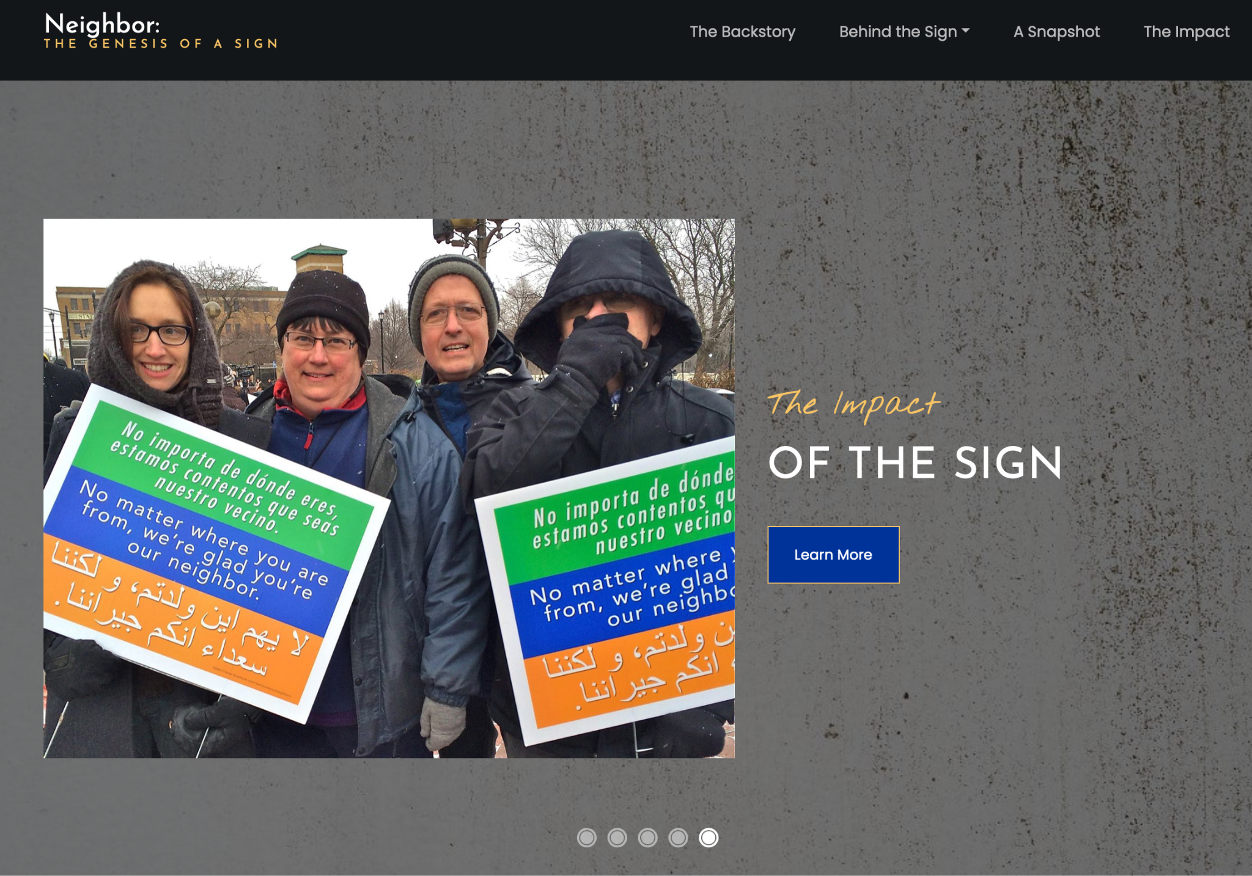
Features
Primarily written story
Photographs, historical docs and interview audio clips to supplement.
Interactive Map with buildings that have been destroyed vs. rennovated/preserved.
Timeline - We want to indicate the construction of the building versus the demolition or preservation.
https://features.propublica.org/illinois-seclusion-rooms/school-students-put-in-isolated-timeouts/
Notes:
Listed above are features that we want on the site and what our story will mainly consist of. The two links are two stories that we like and want to kind of model this story as.

